Slide 1
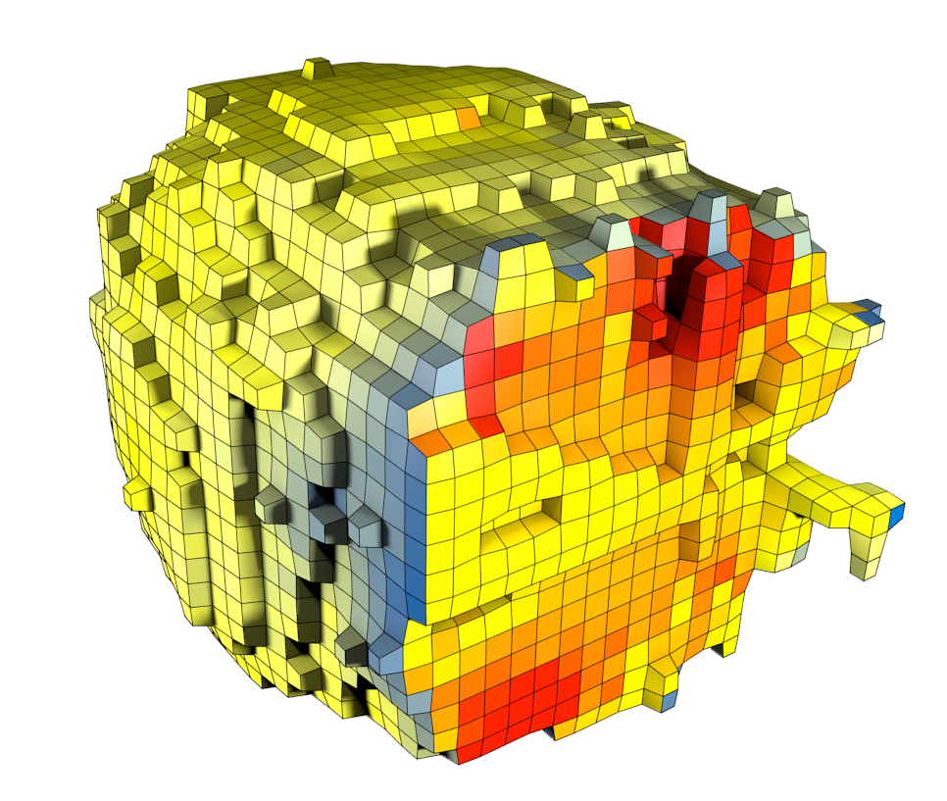

Rule-based spatially resolved modeling of cellular signaling processes
Bastian R. Angermann
Computational Biology Section, Laboratory of Systems Biology, NIAID, NIH
SBFM’12
March 30th 2012

Slide 2
Simmune is a toolkit for spatio-temporal models of signaling processes
Graphical frontends for rules, geometries and simulations
Finite Volume based reaction-diffusion
Cellular Potts model for dynamic morphology as a proof of concept
API for low level access

Slide 3
Simmune combines rule based signaling models with spatially resolved geometries

Slide 4
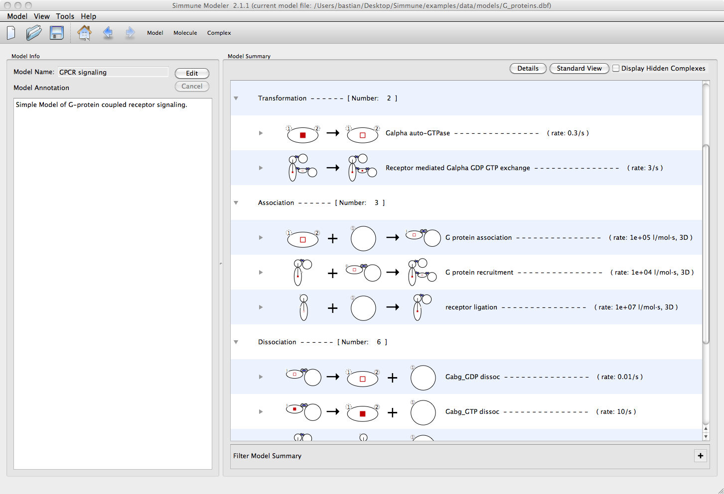
Model specification in Simmune

Slide 5
The network representation in Simmune is 3-Tiered.

Slide 6
Even well stirred, compartmentalized models require localization awareness
Molecule concentrations must be updated in the correct compartments.
Localization is local
Presence of a complex in multiple compartments adds degeneracy.
C
A^{+/-}
C
A⁺
B
C
A⁺
B
C
A⁺
B
Intercellular space
Cytoplasm 1
Cytoplasm 2
Membrane 1
Membrane 2

Slide 7
Information propagates between local networks via diffusion channels
Consider a simple reaction system A+B➔AB
Initial conditions place A at one end of the cell, and B at the other:
Trivial networks (without reactions) containing either A or B will be constructed.

Slide 8
Information propagates between local networks via diffusion channels
Diffusion connectivity propagates the network content until no more changes are made in any local network.
Local networks are notified if their content has changed.

Slide 9
Identified B as binding partner for A.
B in membrane element (ME)?
no
yes
Relevant binding site accessible?
no
yes
Result AB in ME?
Create a rep. of AB in ME, if this was a inter-membrane complex label the result to resolve potential degeneracy.
no
yes
Add the association of A and B with result AB among reactions of ME.
Lookup next interaction of the monomer.

Slide 10
Information propagates between local networks via diffusion channels
Local network updates are done iteratively.
  Cached copies are used when a copy has the same fundamental constituents as the network being updated.
  Searching the cache for the correct network is fast, most candidates are rejected based on their size.
Repeat propagation of network contents and update of local networks until no more changes are made any local network.
…

Slide 11
Spatial representation favors iterative network construction
C
A^{+/-}
C
A⁺
B
Free A⁺ becomes available after the first iteration. Its association with B will propagate during the second iteration.
C
A⁺
B
C
A⁺
B
Intercellular space
Cytoplasm 1
Cytoplasm 2
Membrane 1
Membrane 2

Slide 12
E-cadherin mediated adhesion as an application of rule based spatial modeling

Slide 13
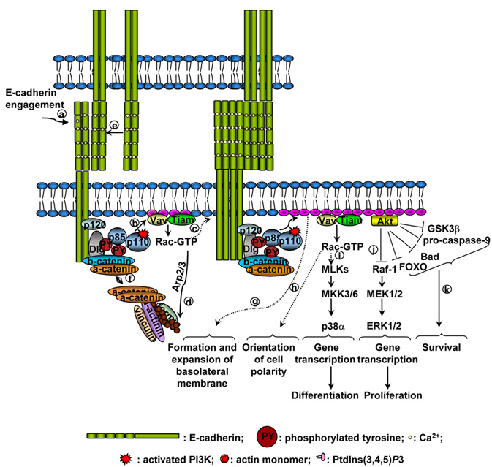
The molecular basis of cell-cell adhesion / E-cadherin interactions
Rivard N, Frontiers in Bioscience 14, 510-522, January 1, 2009

Slide 14
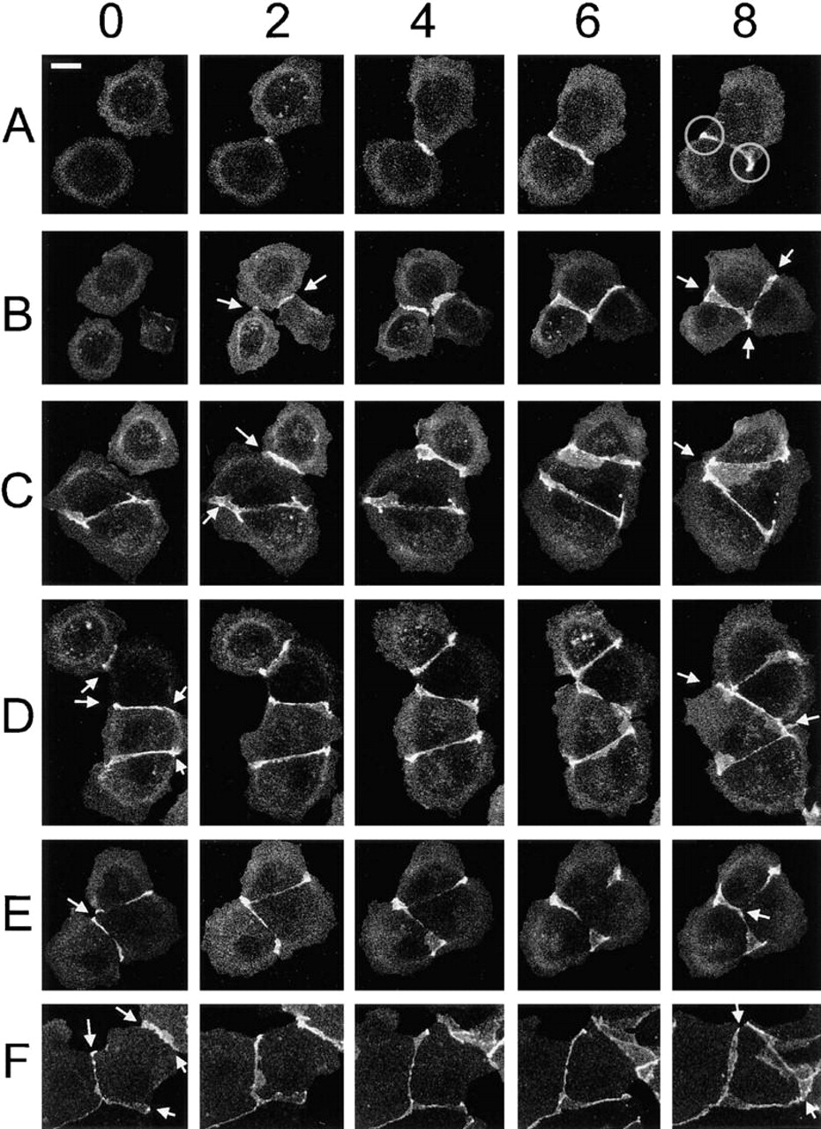
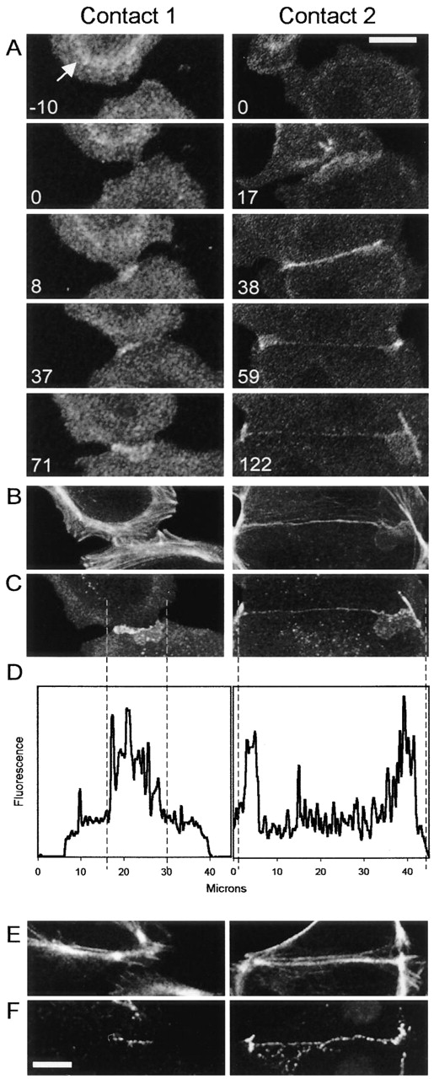
E-cadherin mediated cell contact formation
Cell 2
Cell 1
E-cadherin
accumulation
dist. across interface (microns)
Adams, C.L., Chen, Y.T., Smith, S.J. & Nelson, W.J.
J Cell Biol 142, 1105-1119 (1998)

Slide 15
The molecular basis of cell-cell adhesion / E-cadherin interactions
Rivard N, Frontiers in Bioscience 14, 510-522, January 1, 2009

Slide 16
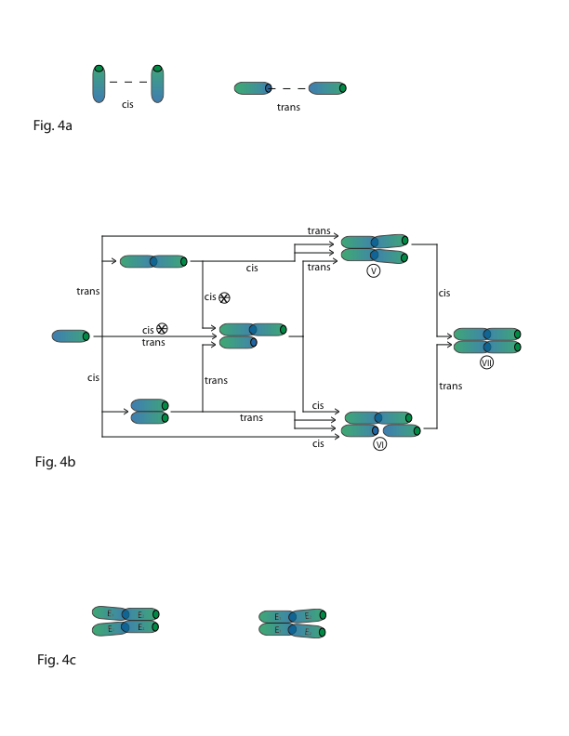
The molecular basis of cell-cell adhesion / E-cadherin interactions
1
trans
2
cis
Trans bindings are stabilized through cis interactions.

Slide 17
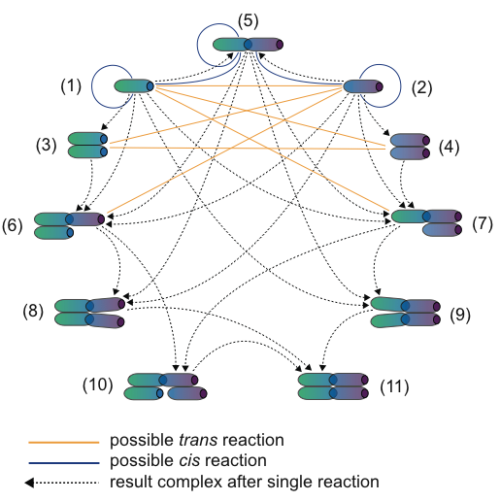
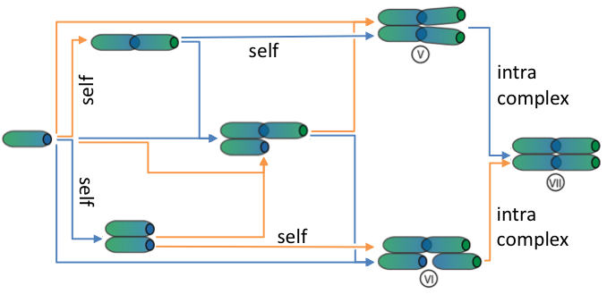
reaction network
between two cells
single molecular
interactions
trans
cis

Slide 18
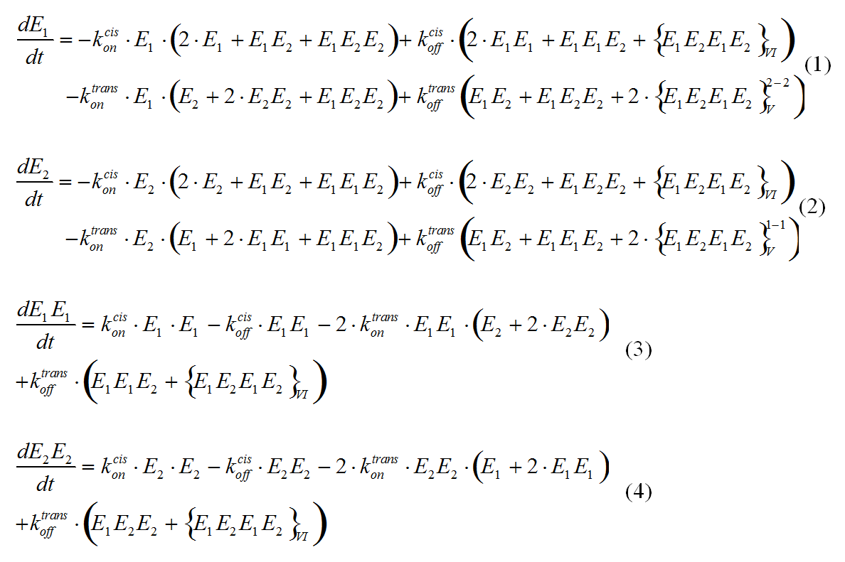
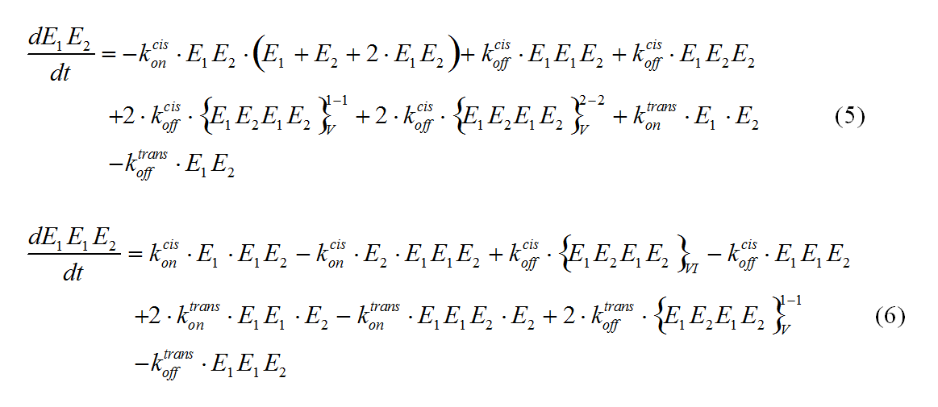
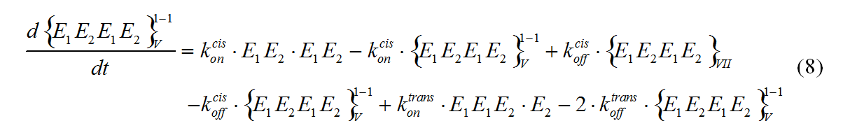
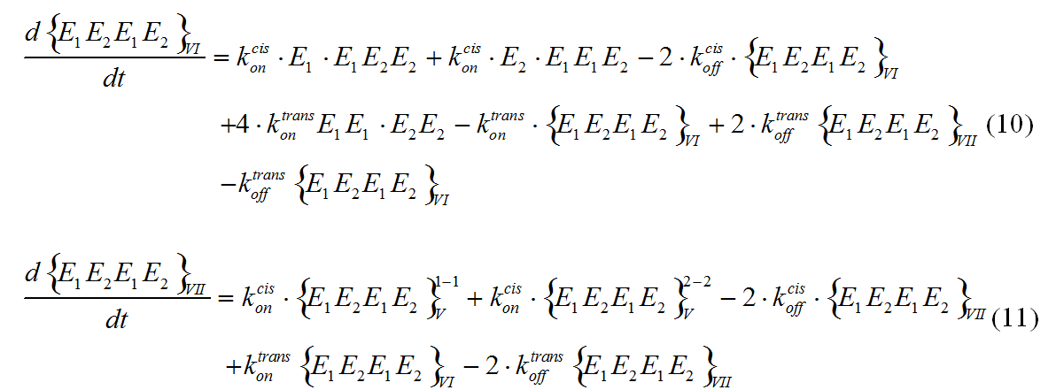
trans
Taking the spatial aspect into account increases
complexity of the signaling network.
cis
…this is an example where it destroys the simple correspondence between localized complexes and biochemical species.

Slide 19
Putting together a model of E-cadherin mediated cell-cell interaction

Slide 20
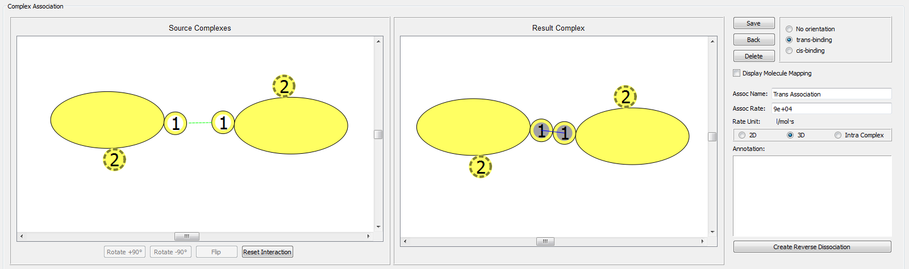
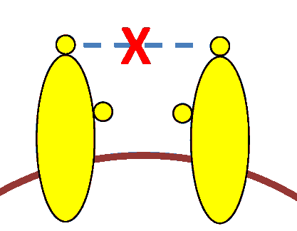
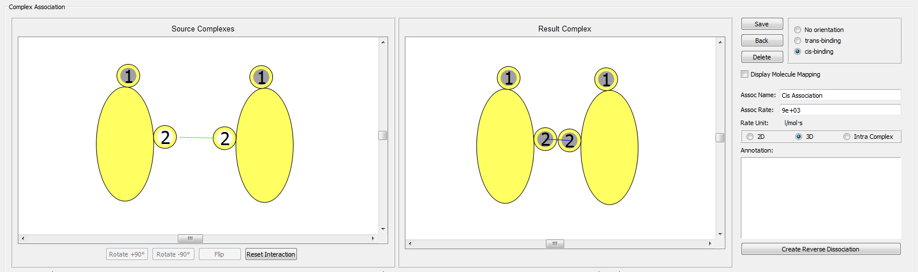
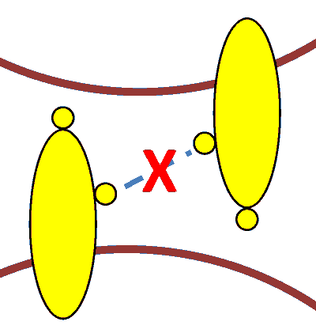
Defining a model of trans- and cis E-cadherin interactions
trans-binding
trans
binding
cis-binding
cis
binding

Slide 21
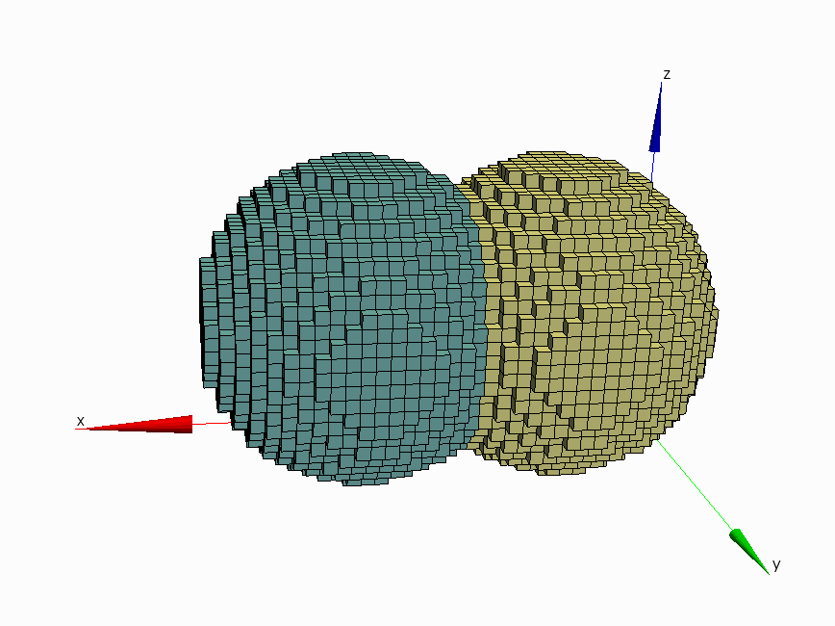
Defining cellular geometries
Cell 1
Cell 2

Slide 22
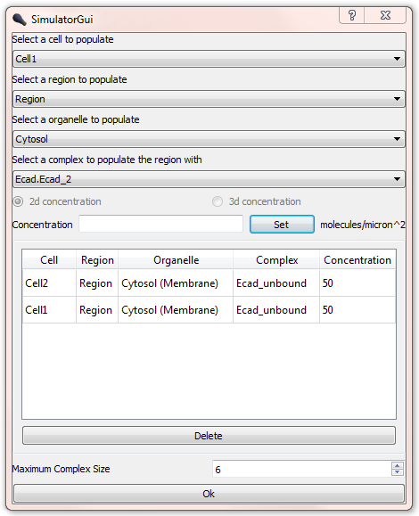
Defining the initial cellular biochemistry

Slide 23
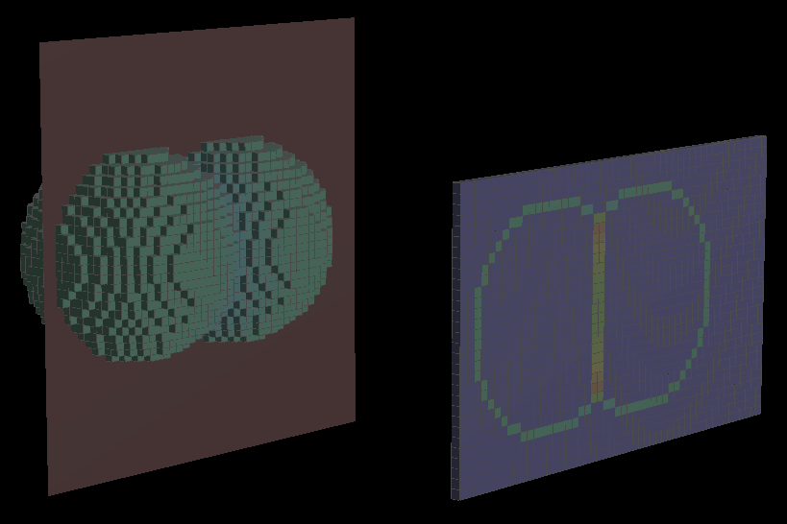
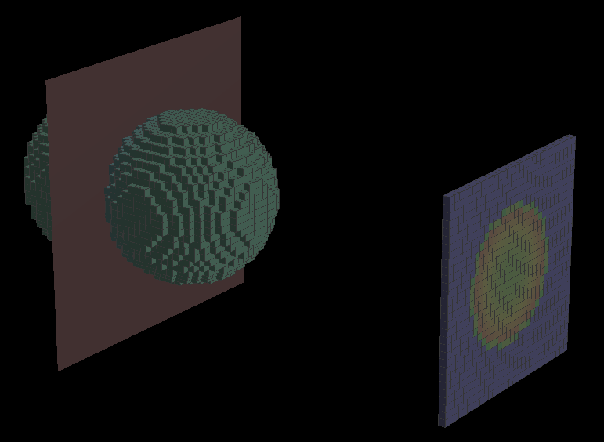
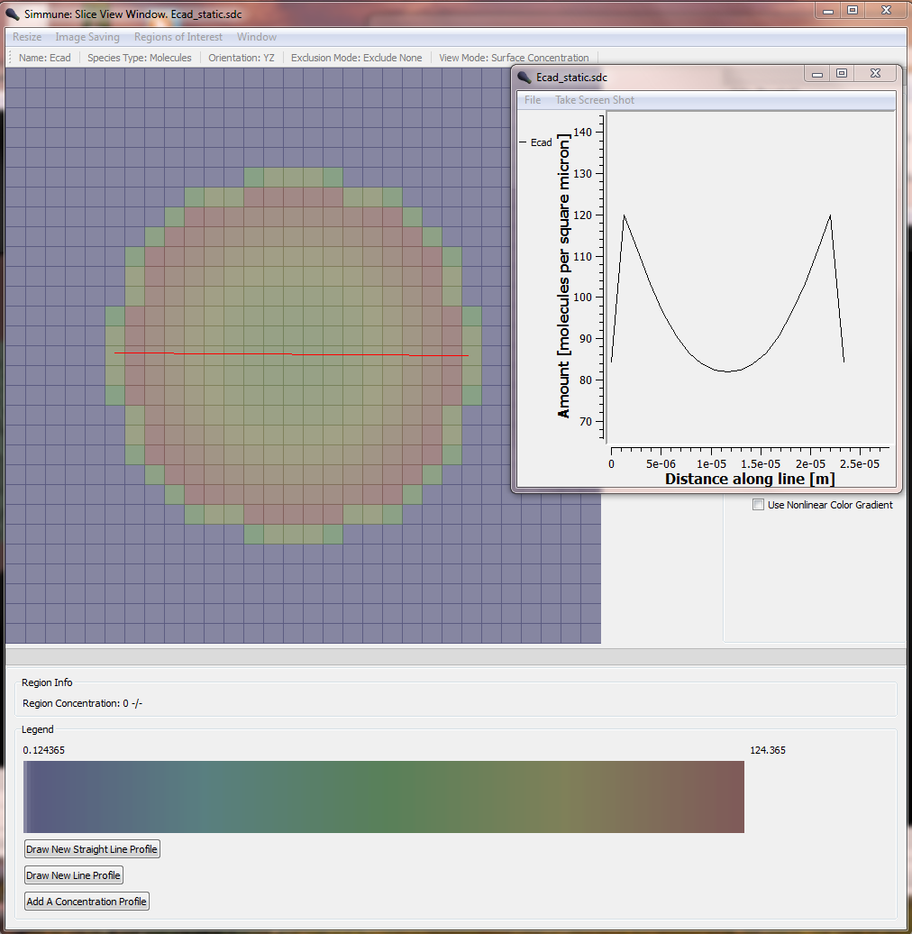
Simulating E-cadherin accumulation at cell interfaces
E-cadherin accumulation after
60 minutes of contact
A static simulation can reproduce the
characteristic accumulation at the
interface of two cells.

Slide 24
Simulating E-cadherin accumulation at dynamic cell interfaces using a Potts Model
Potts Model representation of cells
carry molecular concentrations
of E-cadherin on their surfaces.
Cell1
Cell2
Whenever a change in morphology
or biochemical composition occurs
the resulting signaling network has
to be (re-)built in the affected
regions of the simulated cells.

Slide 25
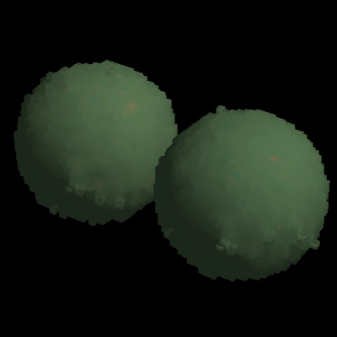
A computational model of E-cadherin mediated cell contact:
Molecular adhesion drives the growth of an intercellular contact.
Local reaction networks are updated dynamically in response to morphology changes.
1 h of simulated time

Slide 26
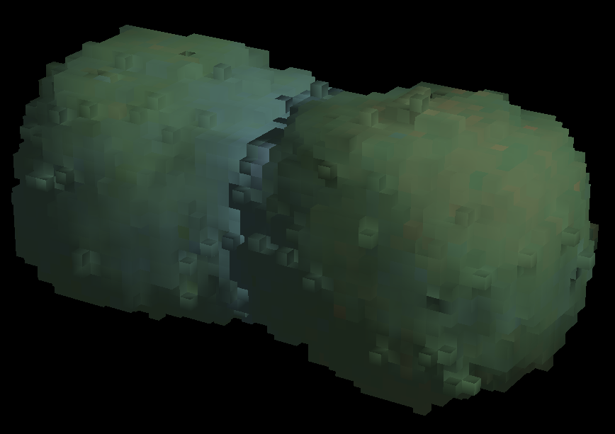
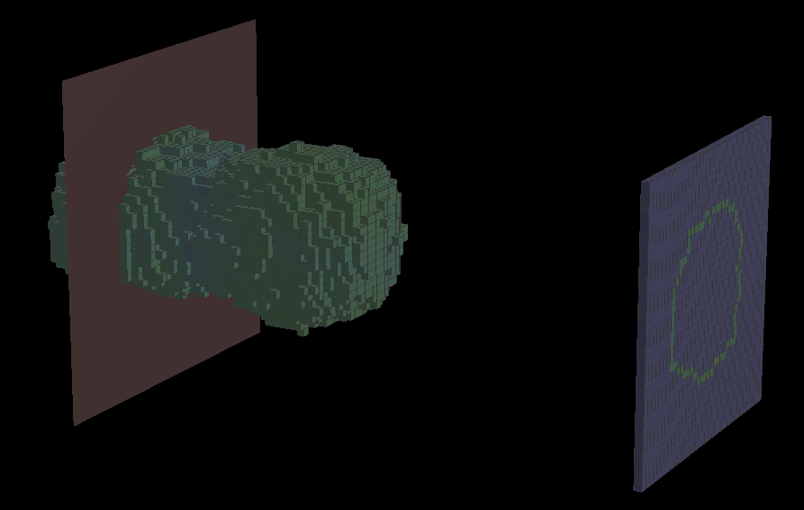
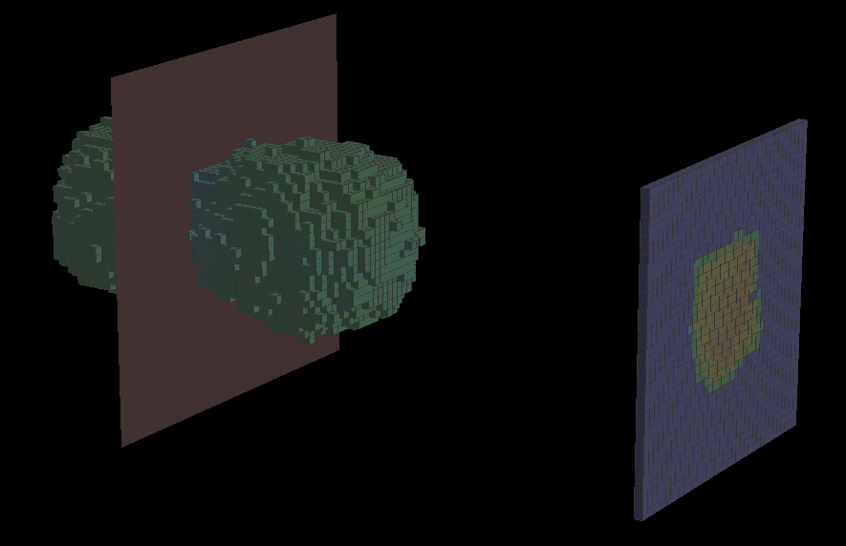
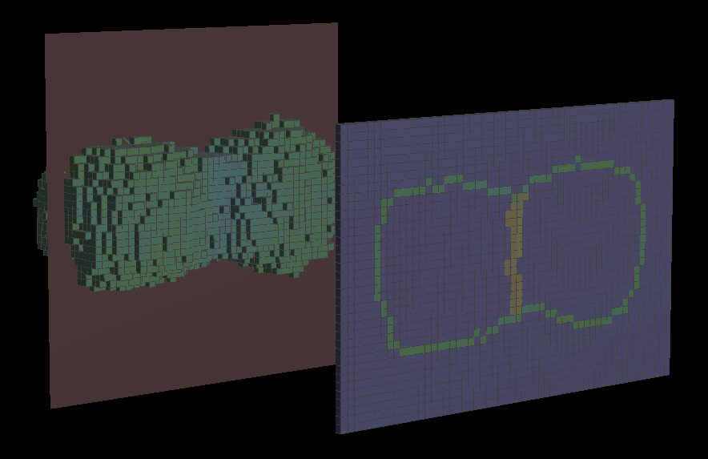
E-cadherin accumulates at the cell-cell contact

Slide 27
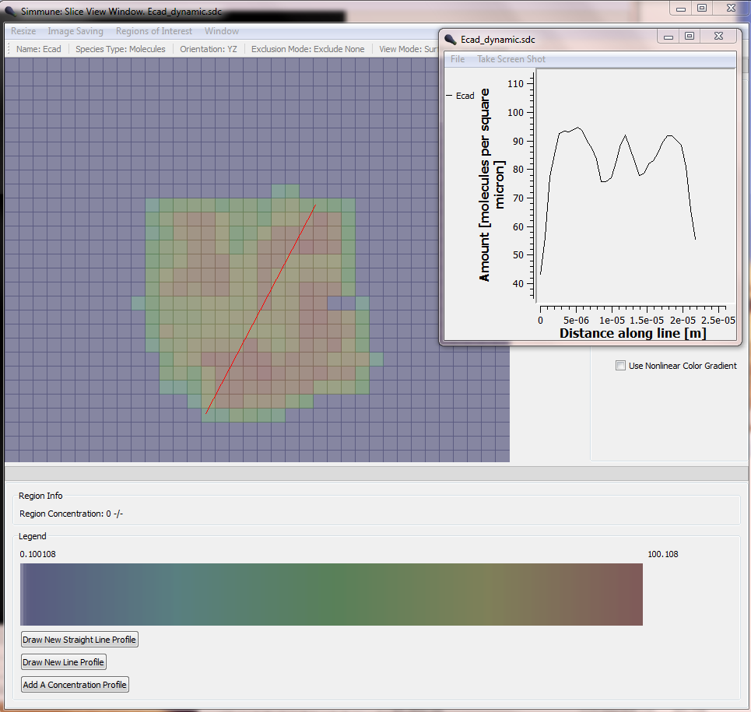
A dynamic simulation of the growing cell-cell contact shows a different behavior of E-cadherin:

Slide 28
Static simulation: E-cadherin becomes trapped at the periphery of the contact region.
Dynamic simulation: E-cadherin accumulates wherever cells form local contacts.
Cadherins diffuse too rapidly to be trapped at the slowly growing periphery.
The cells cannot use passive diffusional trapping to support the edges of the interface
but have to employ active transport of Cadherin complexes (through cortical actin dynamics).

Slide 29
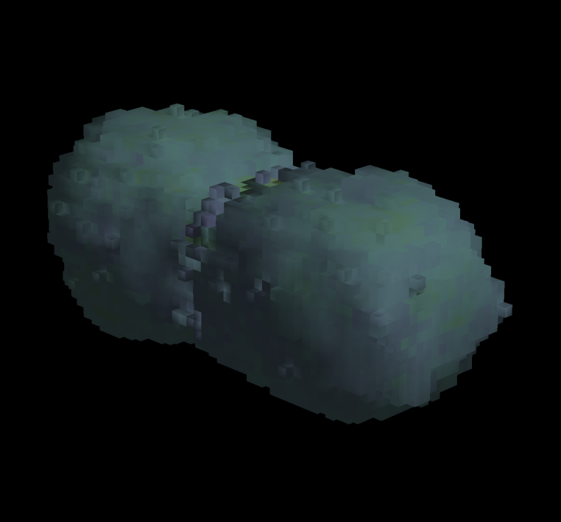
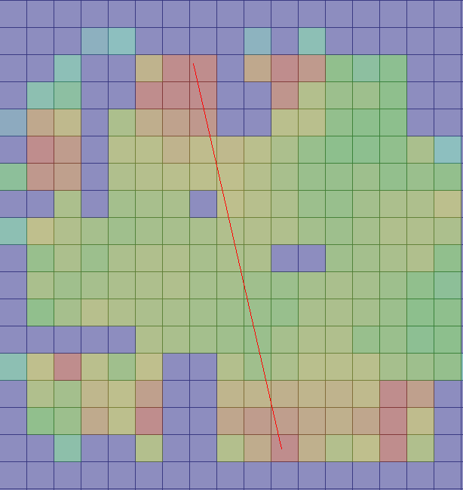
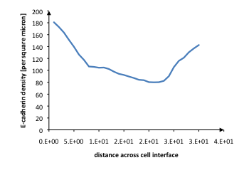
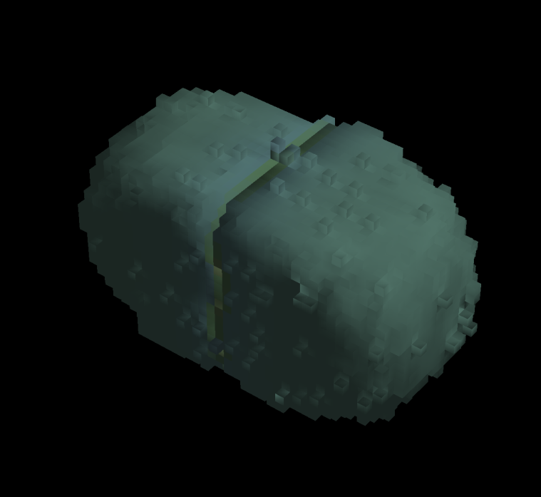
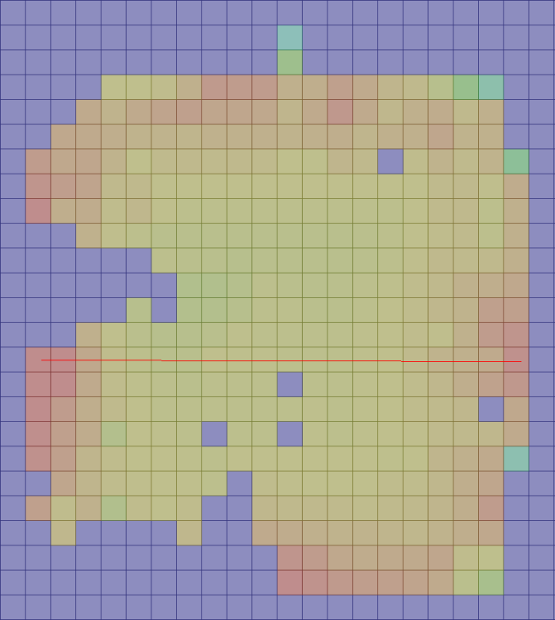
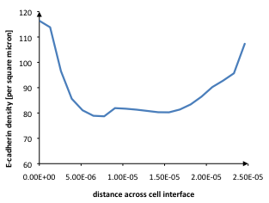
Simulation with 15 times lower diffusion coefficient
Simulation with 5 times faster growth of the contact region

Slide 30
Acknowledgements
Simmune Team
  Martin Meier-Schellersheim¹
  Alex D. Garcia¹
  Frederick Klauschen^{1,2}
  Fengkai Zhang¹
  Thorsten Prüstel¹
Advice
  Ronald N. Germain¹
  Ronald Schwartz⁴
  Rajat Varma¹
  Aleksandra Nita-Lazar¹
  Iain Fraser¹
  John Tsang¹
  D. Cioffi
  Gerhard Mack³
  Members of the LSB
This work was supported by the Intramural Research Program of the US National Institute of Allergy and Infectious Diseases of the National Institutes of Health.
1 Laboratory of Systems Biology, NIAID, NIH
2 Institut für Pathologie, Charité – Universitätsmedizin Berlin
3 II. Institiut für Theroretische Physik, Universität Hamburg
4 Laboratory of Cellular and Molecular Immunology, NIAID, NIH

Slide 31
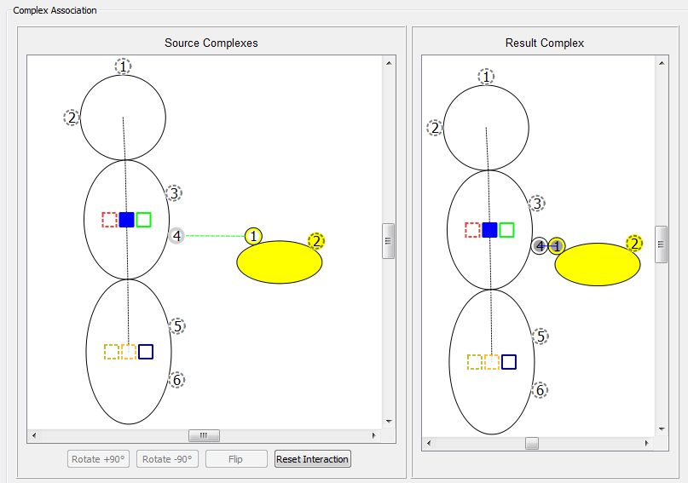

Course on Computational Modeling of Cellular Signaling Processes
Using the Simmune Software Suite
June 4-8, 2012
National Institutes of Health
Bethesda, Maryland
USA
Part 1 (June 4-6)
Creating quantitative models of cellular signaling using visual tools
Performing spatially resolved simulations of cellular biochemistry
Combining biochemical and morphological dynamics
Part 2 (June 6-8)
Using the Simmune software API to develop custom simulations
Participants should ideally bring their own laptop but computers will also be provided on site.
A limited number of scholarships (travel & lodging) is available.
To apply please send an email with subject ‘course’ to: simmune@niaid.nih.gov
Please include a brief statement of your research interests and specify which part(s) of the course you are interested in.
Computational modeling of cellular signaling processes
embedded into dynamic spatial contexts.
Angermann BR, Klauschen F, Garcia AD, Prustel T, Zhang F,
Germain RN, Meier-Schellersheim M.
Nat Methods. 2012 Jan 29. doi: 10.1038/nmeth.1861
http://go.usa.gov/URm

