Slide 1
Tight Bound for the Gap Hamming Distance Problem
Oded Regev
Tel Aviv University
Based on joint paper with
Amit Chakrabarti
Dartmouth College
TexPoint fonts used in EMF.
Read the TexPoint manual before you delete this box.: AAAAAAA

Slide 2
Gap Hamming Distance (GHD)
x∈{0,1}^{n}
y∈{0,1}^{n}
Alice is given x∈{0,1}^{n} and Bob is given y∈{0,1}^{n}
They are promised that either
Δ(x,y) > n/2+√n or Δ(x,y) < n/2-√n.
Their goal is to decide which is the case using the minimum amount of communication
Allowed to use randomization

Slide 3
Gap Hamming Distance (GHD)
Important applications in the data stream model [FlajoletMartin85,AlonMatiasSzegedy99]
  E.g., approximating the number of distinct elements
Equivalent to the Gap Inner Product problem
Alice is given x∈{0,1}^{n} and Bob is given y∈{0,1}^{n}
They are promised that either
Δ(x,y) > n/2+√n or Δ(x,y) < n/2-√n.
Their goal is to decide which is the case using the minimum amount of communication
Allowed to use randomization

Slide 4
Gap Hamming Distance (GHD)
Known upper bound:
  Naïve protocol: n
Known lower bounds:
  Version without a gap: Ω(n)
  Easy lower bound of Ω(√n)
  Lower bound of Ω(n) in the deterministic model [Woodruff07]
  One-round Ω(n) [IndykWoodruff03, JayramKumarSivakumar07]
  Constant-round Ω(n) [BrodyChakrabarti09]
    Improved in [BrodyChakrabartiRegevVidickdeWolf09]
  Nothing better known in the general case!
Given x,y∈{0,1}^{√n}, Alice and Bob apply GHD to x^{√n} and y^{√n}. If Δ(x,y)≥√n/2, Δ(x^{√n},y^{√n})≥n/2;
otherwise, Δ(x^{√n},y^{√n})≤n/2-√n.
Notes:
For deterministic lower bound, one shows no large monochromatic rectangles (even true for O(n) gap)
Quantum is \sqrt{n} (hence discrepancy methods cannot show lower bound)

Slide 5
Our Main Result
We completely resolve the question:
R(GHD) = Θ(n)
Notes:
Implies tight pass/space tradeoffs for approximating number of distinct elements in a stream

Slide 6
The Smooth Rectangle Bound

Slide 7
The Rectangle Bound
Assume there is a randomized protocol that solves GHD with error <0.1 and communication n/1000
Define two distributions:
  μ₀: uniform over x,y∈{0,1}^{n} with Δ(x,y) = n/2-√n
  μ₁ : uniform over x,y∈{0,1}^{n} with Δ(x,y) = n/2+√n
By easy direction of Yao’s lemma, we obtain a deterministic protocol with communication n/1000 that on μ₀ outputs 0 w.p. >0.9 and on μ₁ outputs 1 w.p. >0.9
Notes:
Also called Corruption

Slide 8
The Rectangle Bound
This deterministic protocol defines a partition of the 2^{n}*2^{n} communication matrix into 2^{n/1000} rectangles, each labeled with 0 or 1:

Slide 9
The Rectangle Bound
This deterministic protocol defines a partition of the 2^{n}*2^{n} communication matrix into 2^{n/1000} rectangles, each labeled with 0 or 1:
>0.9
<0.1
0
0
1
0
μ₀: 0.10 0.10 0.14 0.16 0.08 0.07 0.13 0.12 0.01 0.02 0.02 0.01 0.01 0.01 0.01 0.01
μ₁: 0.01 0.02 0.02 0.01 0.01 0.01 0.01 0.01 0.10 0.10 0.14 0.16 0.06 0.09 0.11 0.14
1
0
1
0
0
1
1
<0.1
>0.9
1
0
1
1
0

Slide 10
The Rectangle Bound
In order to reach the desired contradiction, one proves:
For all rectangles R with μ₀(R) ≥ 2^{-n/100},
μ₁(R) ≥ ½ μ₀(R)
>0.9
<0.1
μ₀: 0.10 0.10 0.14 0.16 0.08 0.07 0.13 0.12 0.01 0.02 0.02 0.01 0.01 0.01 0.01 0.01
μ₁: 0.01 0.02 0.02 0.01 0.01 0.01 0.01 0.01 0.10 0.10 0.14 0.16 0.06 0.09 0.11 0.14
<0.1
>0.9

Slide 11
Problem!
Consider
R = { (x,y) | x and y start with 10√n ones }
Then μ₀(R)=2^{-Ω(√n)} but μ₁(R) < 0.001 μ₀(R) !!
The trouble: big unbalanced rectangles exist…
  But apparently they cannot form a partition?

Slide 12
Smooth Rectangle Bound
To resolve this problem, we use a new lower bound technique introduced in [Klauck10, JainKlauck10].
Define three distributions:
  μ₀: uniform over x,y∈{0,1}^{n} with Δ(x,y) = n/2-√n
  μ₁ : uniform over x,y∈{0,1}^{n} with Δ(x,y) = n/2+√n
  μ₂ : uniform over x,y∈{0,1}^{n} with Δ(x,y) = n/2+3√n
Our main technical inequality:
For all rectangles R with μ₁(R) ≥ 2^{-n/100},
(μ₀(R)+μ₂(R))/2 ≥ 0.9 μ₁(R)

Slide 13
Smooth Rectangle Bound
>0.9
<0.1
μ₀: 0.10 0.10 0.14 0.16 0.08 0.07 0.13 0.12 0.01 0.02 0.02 0.01 0.01 0.01 0.01 0.01
μ₁: 0.01 0.02 0.02 0.01 0.01 0.01 0.01 0.01 0.10 0.10 0.14 0.16 0.06 0.09 0.11 0.14
μ₂: * * * * * * * * * * * * *
<0.1
>0.9
>1.5
Contradiction!!
For all rectangles R with μ₁(R) ≥ 2^{-n/100},
(μ₀(R)+μ₂(R))/2 ≥ 0.9 μ₁(R)
Notes:
We now skip some calculations; first the distributions need to be defined slightly differently (with independence between the bits and slightly shifted gap); then one notices that pairs whose Hamming distance is close to n/2 contribute much less to left hand side than right hand side hence we want to exclude those.

Slide 14
The Main Technical Theorem

Slide 15
The Main Technical Theorem
Theorem:
For any sets A,B⊆{0,1}^{n} of measure ≥ 2^{-n/100} the distribution of Δ(x,y)-n/2 where x∼A and y∼B is ‘at least as spread out’ as N(0, 0.49√n)
Example: Take A={all strings starting with n/2 zeros, and ending with a string of Hamming weight n/4}. Similarly for B. Then their measure is 2^{-n/2} but
Δ(x,y) is
always n/2
A
0 0 … 0
0 1 0 1 1 … 1
B
0 1 0 1 1 … 1
0 0 … 0

Slide 16
The Main Technical Theorem:
Gaussian Version
We actually derive the main theorem as a corollary of the analogous statement for Gaussian space (which is much nicer to work with!):
Theorem:
For any sets A,B⊆^{n} of measure ≥ 2^{-n/100} the distribution of ⟨x,y⟩/√n where x∼A and y∼B is ‘at least as spread out’ as N(0,1)
Notes:
It is actually easy to derive; no need for invariance principle

Slide 17
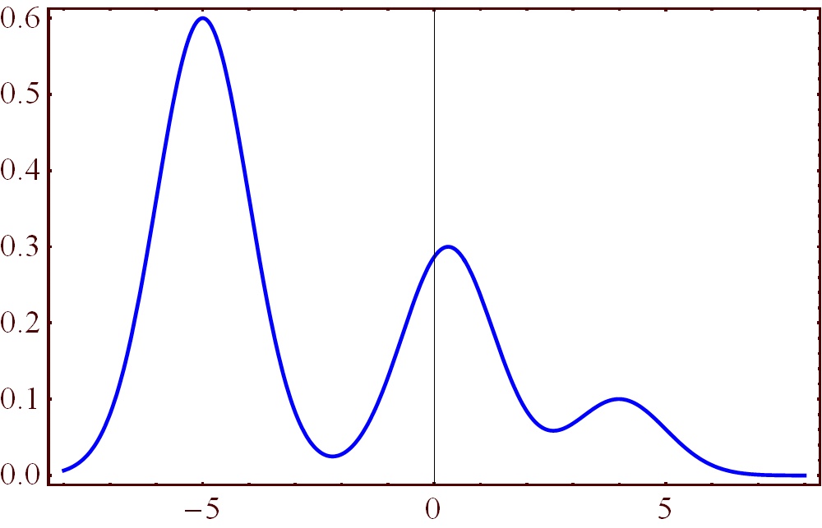
A Stronger Theorem
Our main theorem follows from the following stronger result:
Theorem: Let B⊆^{n} be any set of measure ≥ 2^{-n/100}. Then the projection of B on all but 2^{-n/50} of directions is distributed like the sum of N(0,1) and an independent r.v.
(i.e., a mixture of normals
with variance 1)

Slide 18
Lemma 1 – Hypercube Version
Lemma 1’:
Let B⊆{0,1}^{n} be of size ≥2^{0.99n} and let b=(b₁,…,b_{n}) be uniformly distributed in B. Then for 90% of indices k∈{1,…,n}, b_{k} is close to uniform (even when conditioned on b₁,…,b_{k-1}).
Proof:
Since entropy of a bit is never bigger than 1, most summands are very close to 1.

Slide 19
Lemma 1
Lemma 1:
For any set B⊆^{n} of measure γ(B)≥2^{-n/100} and any orthonormal basis x₁,…,x_{n}, it holds that for 90% of indices k∈{1,…,n}, ⟨B,x_{k}⟩ is close to N(0,1) (even when conditioned on ⟨B,x₁⟩,…, ⟨B,x_{k-1}⟩)

Slide 20
Lemma 2
Lemma 2 [Raz’99]:
Any set A’⊆^{n-1} of at least ≥2^{-n/50} directions contains a set of 1/10-orthogonal vectors x₁,…,x_{n/2}.
(i.e., the projection of each x_{i} on the span of x₁,…,x_{i-1} is of length at most 1/10)
Proof: Based on the isoperimetric inequality
x₂
x₁
Notes:
We will talk about Vertex Cover

Slide 21
Completing the Proof
Theorem: Let B⊆^{n} be any set of measure ≥ 2^{-n/100}. Then the projection of B on all but 2^{-n/50} of directions is distributed like the sum of N(0,1) and an independent r.v.
Proof:
Let A’ be the set of ‘bad’ directions and assume by contradiction that its measure is ≥2^{-n/50}
Let x₁,…,x_{n/2}∈A’ be the vectors given by Lemma 2
If they were orthogonal, then by Lemma 1, there is a k (in fact, most k) s.t. ⟨B,x_{k}⟩ is close to N(0,1), in contradiction
Since they are only 1/10-orthogonal, we obtain that ⟨B,x_{k}⟩ is distributed like the sum of N(0,1) and an independent r.v., in contradiction.

Slide 22
Open Questions
Our main technical theorem can be seen as a (weak) symmetric analogue of a result by [Borell’85]
  (which was used in the proof of the Majority in Stablest Theorem [Mossell O’Donnell Oleszkiewicz’05])
  Can one prove a tight inequality as done by Borell? Symmetrization techniques do not seem to help...
Other applications of the technique?

