Slide 1
Quantum One-Way Communication
is Exponentially Stronger than
Classical Communication
Bo’az Klartag
Tel Aviv University
Oded Regev
Tel Aviv University
TexPoint fonts used in EMF.
Read the TexPoint manual before you delete this box.: AAAAAAA

Slide 2
Communication Complexity
x
y
f(x,y)
Alice is given input x and Bob is given y
Their goal is to compute some (possibly partial) function f(x,y) using the minimum amount of communication
Two central models:
Classical (randomized bounded-error) communication
Quantum communication

Slide 3
Relation Between Models
[Raz’99] presented a function that can be solved using O(logn) qubits of communication, but requires poly(n) bits of randomized communication
Hence, Raz showed that:
quantum communication
is exponentially stronger than
classical communication
This is one of the most fundamental results in the area
Notes:
Mention Buhrman-Cleve-Wigderson and Ambainis-Schulman-TaShma-Vazirani-Wigderson

Slide 4
Is One-way Communication Enough?
Raz’s quantum protocol, however, requires two rounds of communication
This naturally leads to the following fundamental question:
Is quantum one-way communication exponentially stronger than classical communication?

Slide 5
Previous Work
[BarYossef-Jayram-Kerenidis’04] showed a relational problem for which quantum one-way communication is exponentially stronger than classical one-way
This was improved to a (partial) function by [Gavinsky-Kempe-Kerenidis-Raz-deWolf’07]
[Gavinsky’08] showed a relational problem for which quantum one-way communication is exponentially stronger than classical communication

Slide 6
Our Result
We present a problem with a O(logn) quantum one-way protocol that requires poly(n) communication classically
Hence our result shows that:
quantum one-way communication
is exponentially stronger than
classical communication
This might be the strongest possible separation between quantum and classical communication

Slide 7
Vector in Subspace Problem [Kremer95,Raz99]
W⊆^{n}
n/2-dim
subspace
v∈^{n}
Alice is given a unit vector v∈^{n} and Bob is given an n/2-dimensional subspace W ⊆ ^{n}
They are promised that either
v is in W or v is in W⊥
Their goal is to decide which is the case using the minimum amount of communication

Slide 8
Vector in Subspace Problem
There is an easy logn qubit one-way protocol
Alice sends a logn qubit state corresponding to her input and Bob performs the projective measurement specified by his input
No classical lower bound was known
We settle the open question by proving:
R(VIS)=Ω(n^{1/3})
This is nearly tight as there is an O(n^{1/2}) protocol

Slide 9
Open Questions
Improve the lower bound to a tight n^{1/2}
Should be possible using the “smooth rectangle bound”
Improve to a functional separation between quantum SMP and classical
Seems very challenging, and maybe even impossible

Slide 10
The Proof

Slide 11
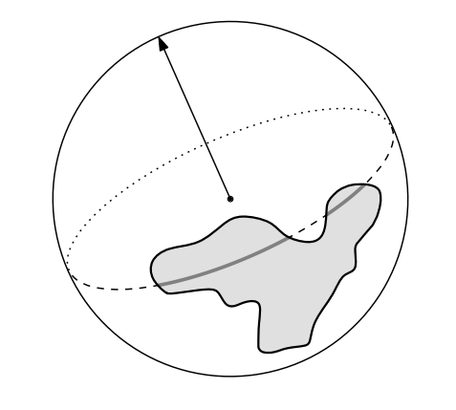
The Main Sampling Statement
A routine application of the rectangle bound (which we omit), shows that the following implies the Ω(n^{1/3}) lower bound:
Thm 1: Let A⊆S^{n-1} be an arbitrary set of measure at least exp(-n^{1/3}). Let H be a uniform n/2 dimensional subspace. Then, the measure of A∩H is 1±0.1 that
of A except with probability
at most exp(-n^{1/3}).
Remark: this is tight
A

Slide 12
Sampling Statement for Equators
Thm 1 is proven by a recursive application of the following:
Thm 2: Let A⊆S^{n-1} be an arbitrary
set of measure at least exp(-n^{1/3}). Let H be a uniform n-1 dimensional subspace. Then, the measure of A∩H is 1±t that
of A except with probability at most
exp(-t n^{2/3}).
So the error is typically
1±n^{-2/3} and has
exponential tail
A

Slide 13
Thm 1 from Thm 2
Here is an equivalent way to choose a uniform n/2 dimensional subspace:
First choose a uniform n-1 dimensional subspace, then choose inside it a uniform n-2 dimensional subspace, etc.
Thm 2 shows that at each step we get an extra multiplicative error of 1±n^{-2/3}. Hence, after n/2 steps, the error becomes 1±n^{1/2}·n^{-2/3}= 1±n^{-1/6}
Assuming a normal behavior, this means probability of deviating by more than 1±0.1 is at most exp(-n^{1/3})
(Actually proving all of this requires a very delicate martingale argument…)

Slide 14
Proof of Theorem 2
The proof of Theorem 2 is based on:
the hypercontractive inequality on the sphere,
the Radon transform, and
spherical harmonics.
We now present a proof of an analogous statement in the possibly more familiar setting of the hypercube {0,1}^{n}
A

Slide 15
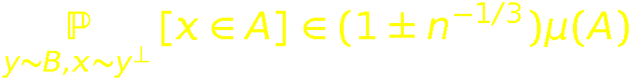
Hypercube Sampling
For y∈{0,1}^{n} let y⊥ be the set of all w∈{0,1}^{n} at Hamming distance n/2 from y
Let A⊆{0,1}^{n} be of measure μ(A):=|A|/2^{n} at least exp(-n^{1/3})
Assume we choose a uniform y∈{0,1}^{n}
Then our goal is to show that the fraction of points of y⊥ contained in A is (1±n^{-1/3})μ(A) except with probability at most exp(-n^{1/3})
(This is actually false for a minor technical reason…)
Equivalently, our goal is to prove that for all A,B ⊆{0,1}^{n} of measure at least exp(-n^{1/3}),

Slide 16

Radon Transform
For a function f:{0,1}^{n}→, define its Radon transform R(f):{0,1}^{n}→ as
Define f=1_{A}/μ(A) and g=1_{B}/μ(B)
Then our goal is to prove

Slide 17

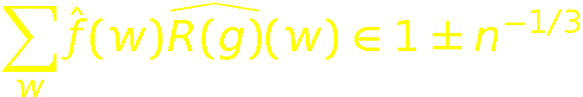
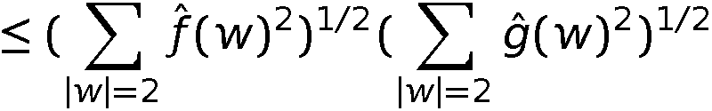
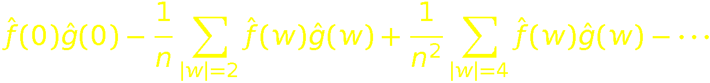
Fourier Transform
So our goal is to prove
This is equivalent to
It is easy to check that R is diagonal in the Fourier basis, and that its eigenvalues are 1,0,-1/n,0,1/n²,… Hence above sum is equal to:
^{Negligible}

Slide 18
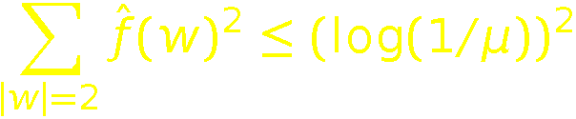
Average Bias
Lemma [Gavinsky-Kempe-Kerenidis-Raz-deWolf’07]: Let A⊆{0,1}^{n} be of measure μ, and let f=1_{A}/μ(A) be its normalized indicator function. Then,
Equivalently, this lemma says the following: if (x₁,…,x_{n}) is uniformly chosen from A, then the sum over all pairs {i,j} of the bias squared of x_{i}⊕x_{j} is at most (log(1/μ))².
This is tight: take, e.g.,

Slide 19
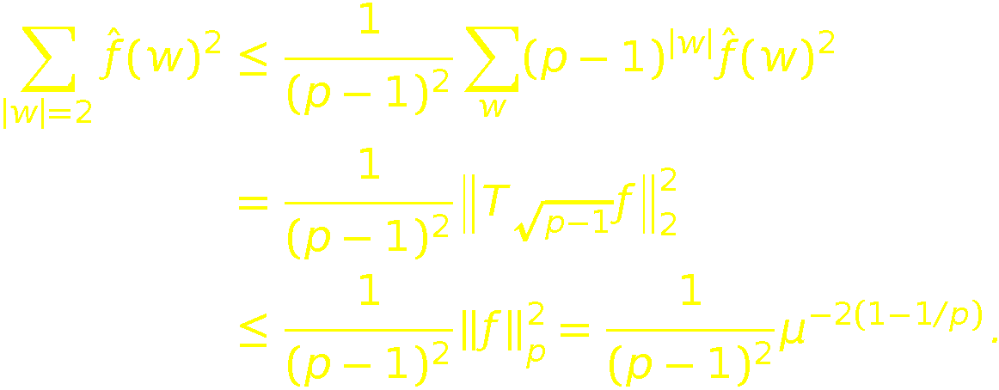
Average Bias
Lemma [Gavinsky-Kempe-Kerenidis-Raz-deWolf’07]: Let A⊆{0,1}^{n} be of measure μ, and let f=1_{A}/μ(A) be its normalized indicator function. Then,
Proof: By the hypercontractive inequality, for all 1≤p≤2,

